Slide 1
AEES Distance Learning
Class : XI
Subject : Compute Science
Module No : M07
Module Name : Python Comments
Prepared by :
G.Tamil Vendan,PGT(SS),AECS,Jaduguda

Slide 2
Python Comments
Programming reflects our way of thinking in order to describe the single steps that we took to solve a problem using a computer. Commenting our code helps explain our thought process, and help us to understand later on the intention of our code. This allows us to more easily find errors, to fix them, to improve the code later on, and to reuse it in other applications as well.
Commenting is important to all kinds of projects, no matter whether they are - small, medium, or rather large. It is an essential part of your workflow, and is seen as good practice for developers. Without comments, things can get confusing, real fast. In this Presentation we will understand the various methods of commenting in Python.

Slide 3
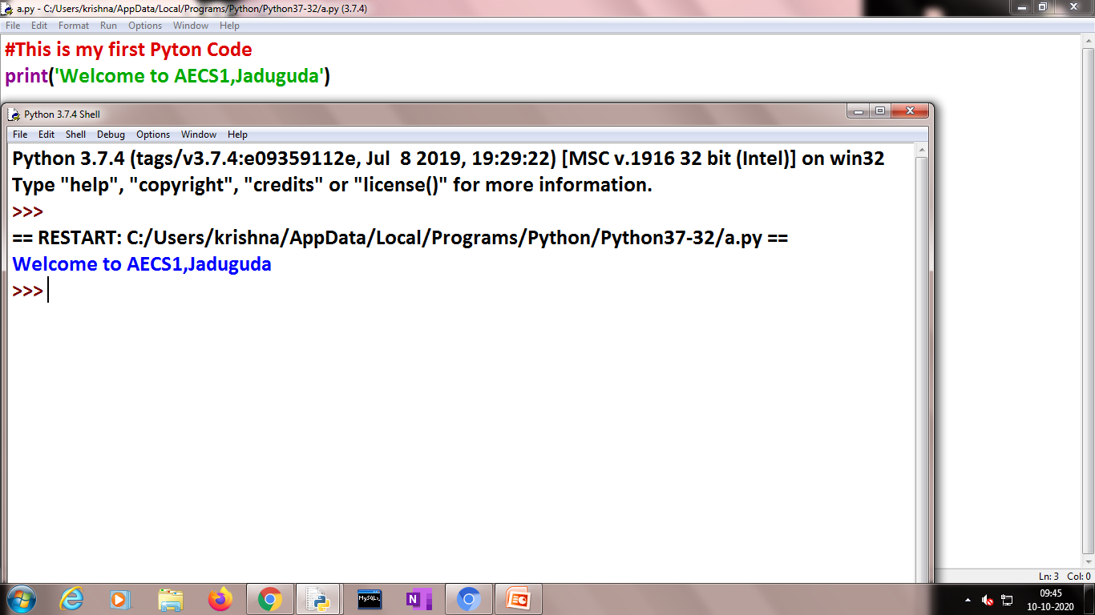
Comments can be used to explain Python code.
Comments can be used to make the code more readable.
Comments can be used to prevent execution when testing code.
Creating a Comment
Comments starts with a #, and Python will ignore them:

Slide 4
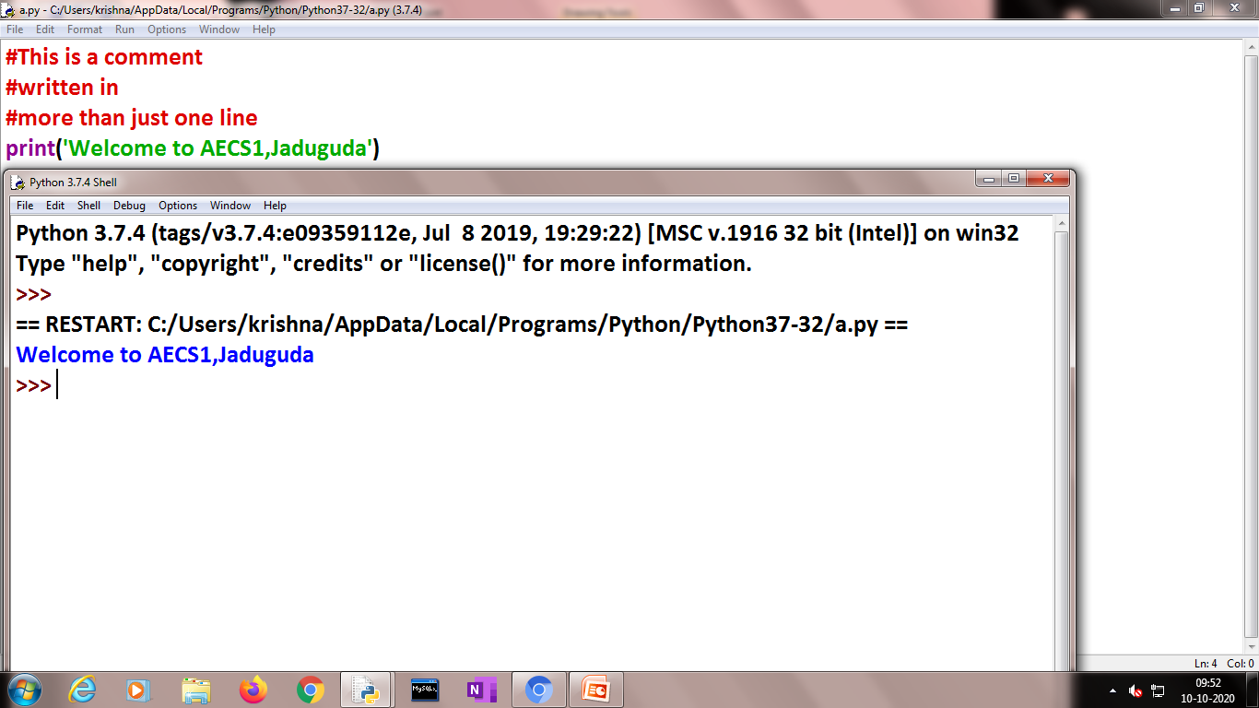
Multi Line Comments
Python does not really have a syntax for multi line comments.
To add a multiline comment you could insert a # for each line:

Slide 5
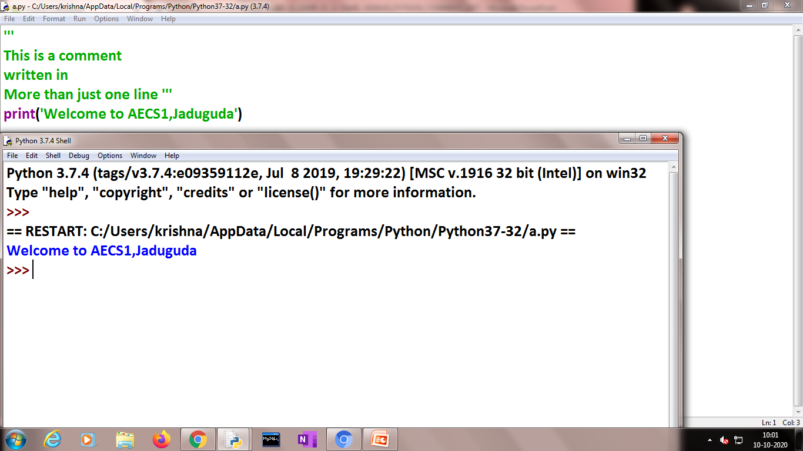
Multi Line Comments
Or , you can use a multiline string.
Since Python will ignore string literals that are not assigned to a variable, you can add a multiline string (triple quotes) in your code, and place your comment inside it:

Slide 6
Thank you..

