Slide 1
AEES Distance Learning
Class : XI
Subject : Computer Science
Module No : M08
Module Name : Python Variables
Prepared by :
G.Tamil Vendan,PGT(SS),AECS,Jaduguda

Slide 2
Python Variables
Variables are nothing but reserved memory locations to store values. This means that when you create a variable you reserve some space in memory.
Based on the data type of a variable, the interpreter allocates memory and decides what can be stored in the reserved memory. Therefore, by assigning different data types to variables, you can store integers, decimals or characters in these variable

Slide 3
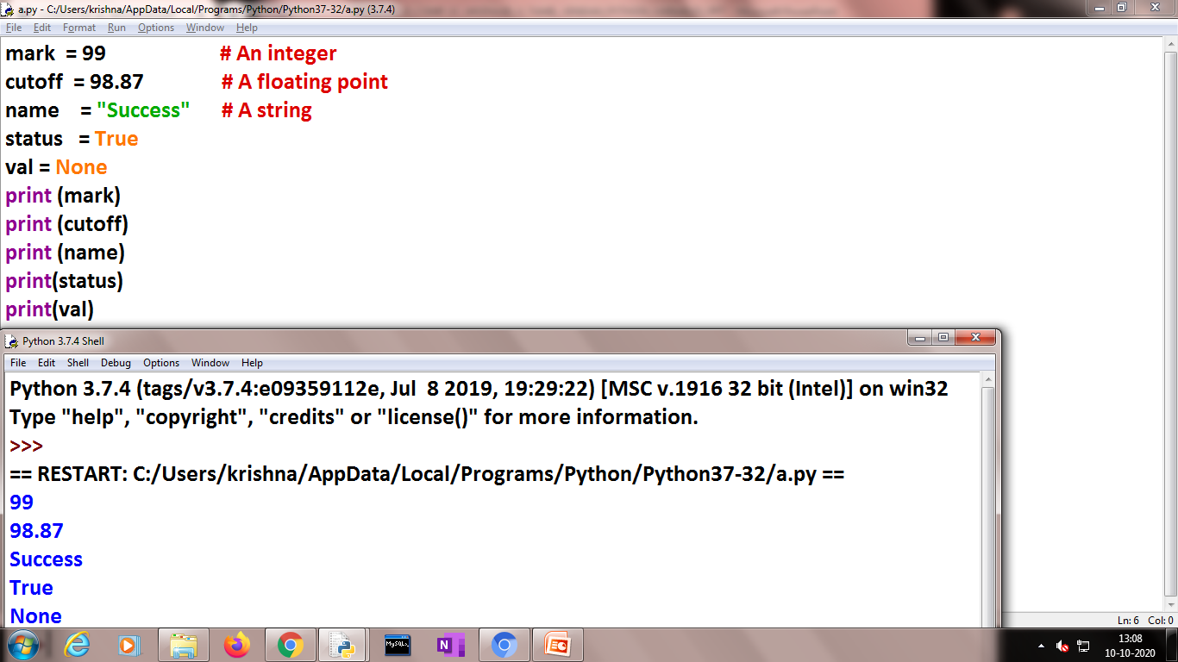
Assigning Values to Variables
Python variables do not need explicit declaration to reserve memory space. The declaration happens automatically when you assign a value to a variable. The equal sign (=) is used to assign values to variables.
The operand to the left of the = operator is the name of the variable and the operand to the right of the = operator is the value stored in the variable. Example:

Slide 4
Variable Naming Rules
Must begin with a letter (a - z, A - B) or underscore (_)
Other characters can be letters, numbers or _
Case Sensitive
Can be any (reasonable) length
There are some reserved words which you cannot use as a variable name because Python uses them for other things.

Slide 5
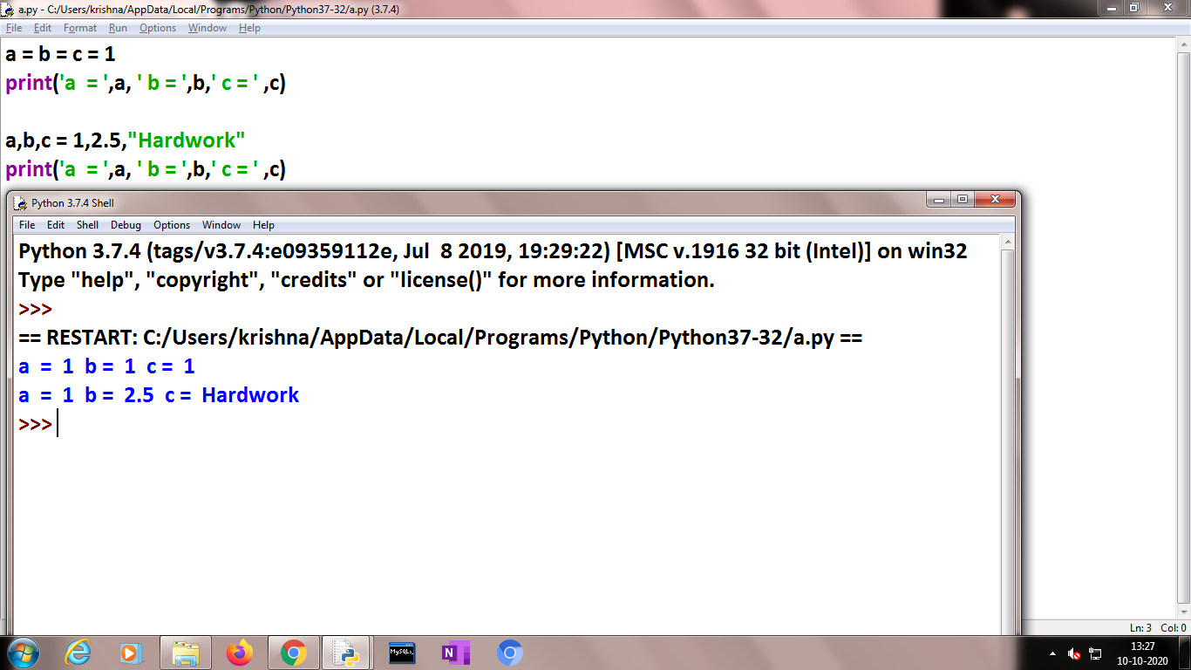
Multiple Assignment
Python allows you to assign a single value to several variables simultaneously.
You can also assign multiple objects to multiple variables

Slide 6
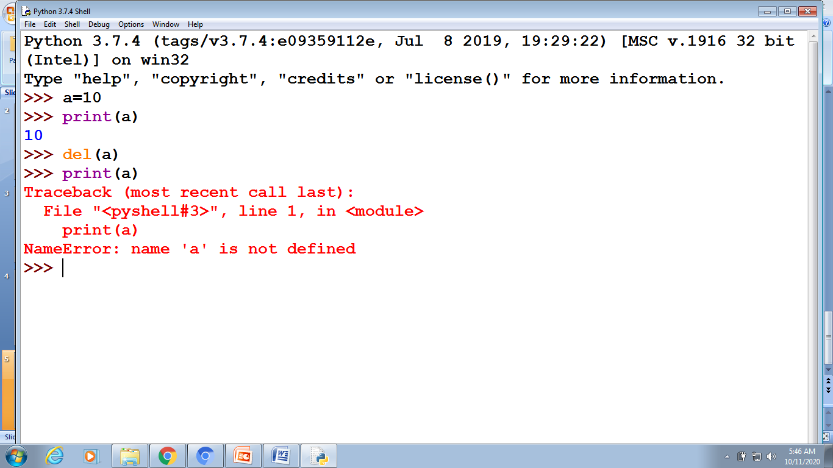
Deleting a variable
A variable in Python is deleted using the del() function.
The del function deletes variables, lists, dictionaries and more. Similarly, it also deletes the single or multiple elements of a list or dictionary simultaneously.

Slide 7
Assignment Operators in Python
Operator | Description | Example
= | Assigns values from right side operands to left side operand | c = a + b assigns value of a + b into c
+= Add AND | It adds right operand to the left operand and assign the result to left operand | c += a is equivalent to c = c + a
-= Subtract AND | It subtracts right operand from the left operand and assign the result to left operand | c -= a is equivalent to c = c - a
*= Multiply AND | It multiplies right operand with the left operand and assign the result to left operand | c *= a is equivalent to c = c * a
/= Divide AND | It divides left operand with the right operand and assign the result to left operand | c /= a is equivalent to c = c / a
%= Modulus AND | It takes modulus using two operands and assign the result to left operand | c %= a is equivalent to c = c % a
**= Exponent AND | Performs exponential (power) calculation on operators and assign value to the left operand | c **= a is equivalent to c = c ** a
//= Floor Division | It performs floor division on operators and assign value to the left operand | c //= a is equivalent to c = c // a

Slide 8
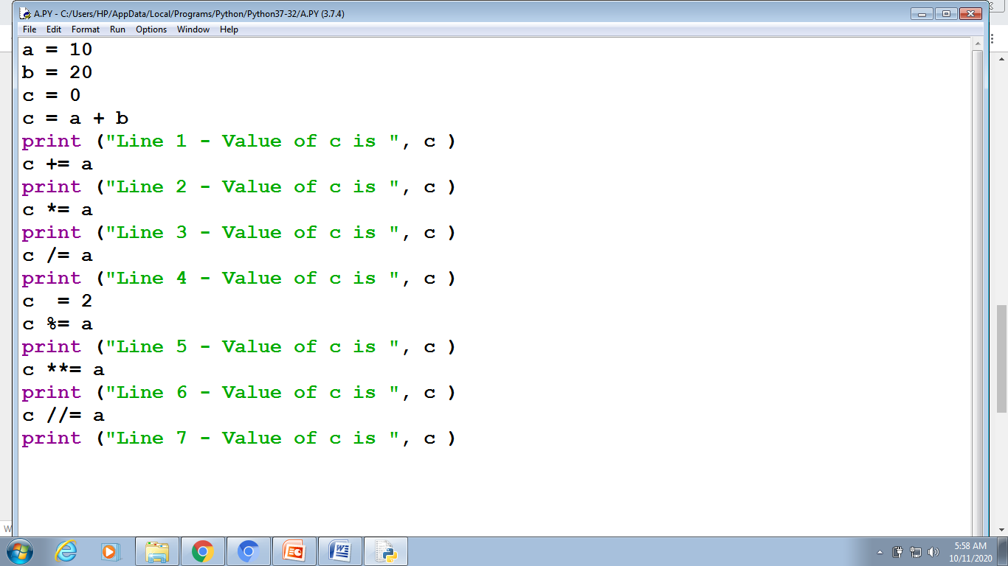
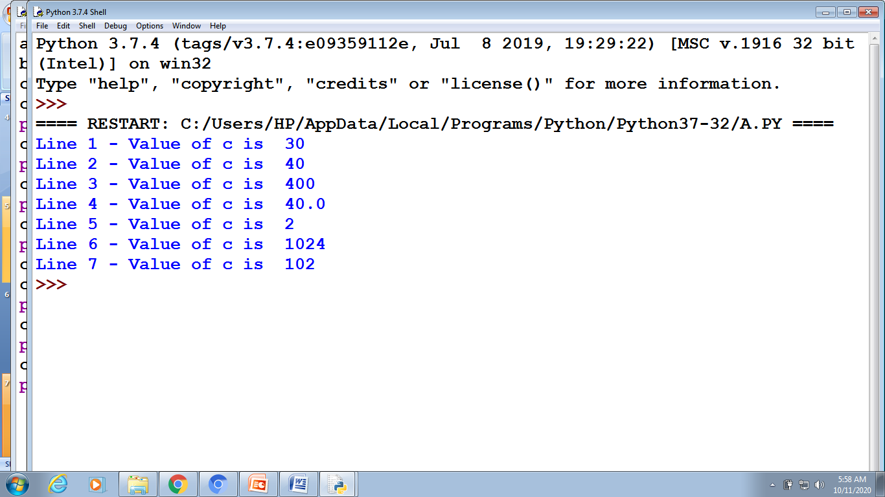

Slide 9
Concept of L-Value and R-Value
An lvalue (locator value) represents an object that occupies some identifiable location in memory (i.e. has an address). rvalues are defined by exclusion. Every expression is either an lvalue or an rvalue, so, an rvalue is an expression that does not represent an object occupying some identifiable location in memory.
a,b=1,2
print(a,b)
a,_,b=1,2,3
print(a,b)
a,b=10,20
print(a,b)
a,b=b,a
print(a,b)
>>>
==== RESTART: C:/Users/HP/AppData/Local/Programs/Python/Python37-32/A.PY ====
1 2
1 3
10 20
20 10
>>>

Slide 10
(a) A left value or l-value is an assignable object. It is any expression that may occur on the left side of an assignment. Variables are obvious l-values, but so are items in lists.
(b) A right value or r-value is any expression that has a value that may appear on the right of an assignment. In python, everything is an r-value.
(c) Traditionally, the underscore ( _) is used as a place-holder for an l-value when we don't care about the result of the assignment.
(d) In assignment, a tuple of l-values is, itself an l-value:
>>> (a,b,c) = (1,2,3) >>> a,b,c = 1,2,3 >>> (a,b),_,c = (1,2,),9,3 Each of these effectively assigns a=1, b=2, and c=3.
(e) These complex assignments happen in parallel, so we can exchange values with: >>> a,b = b,a Really: it's tuple assignment!

Slide 11
Thank You…

