Slide 1
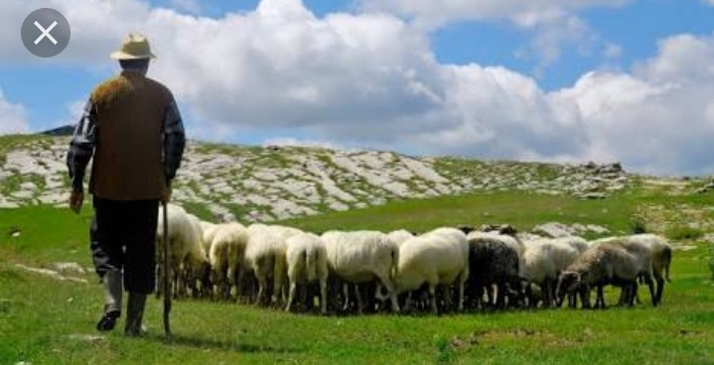
The Shepherd's Treasure
Module-1/1
A Pact with the Sun
Supplementary Reader
CLASS 6TH

Slide 2
In a village in Iran there once lived a shepherd. He was very poor. He did not have even a small cottage of his own.
He had never been to school or learnt to read and write, for there were very few schools in those days.

Slide 3
Though poor and uneducated, this shepherd was very wise. He understood people’s sorrows and troubles, and helped them face their problems with courage and common sense. Many people came to him for advice. Soon he became famous for his wisdom and friendly nature.

Slide 4
Soon the king heard about the shepherd. He decided to visit the shepherd. He took the dress of a shepherd and went to the cave of the wise shepherd on the mule. As soon as the shepherd saw the traveler coming towards the cave ,he rose to welcome him. He took the tired traveler inside the cave ,and shared his own meager meal.

Slide 5
The king rested for the night in the cave and was greatly impressed by the shepherd’s hospitality and wise conversation and made him the governor of a small district.
•

Slide 6
The new governor won people’s love, he became famous as fair and wise governor.
Now the governors of other provinces grew terribly jealous of him and began to talk to the king against him. They said, “He is very dishonest, and keeps for himself part of the money that he collects as tax from the people.”

Slide 7
At first the king did not believe these reports
But he could do so for long.
The new governor always carried an iron chest with him.
So one day the King called the new Governor to the palace.

Slide 8
THE SHEPHERD comes to the palace with the iron box
The shepherd came to the palace on the camel. His iron chest was also tied with the camel. Now the king was angry. He thundered, “why do you keep this iron chest with you. What does it contain”? The shepherd smiled and asked his servant to bring the chest. Every people were eager to know what’s inside the chest.

Slide 9
• The iron chest was opened
The chest contained no gold or silver.
There was an old blanket in the box
.The shepherd said that it was his only treasure and the oldest friend.
He also said that it would protect him if , the king should wish to take away his new cloak .
The king was pleased with the shepherd’s humble behavior, humility and honesty.
He made him the governor of a much bigger province that very day.

Slide 10
The moral of the story
In this story, we see that a shepherd rose to the position of governor with his wisdom kindness ,humility and humble nature ,and even after becoming governor he remained as humble as he was earlier.

