Slide 1
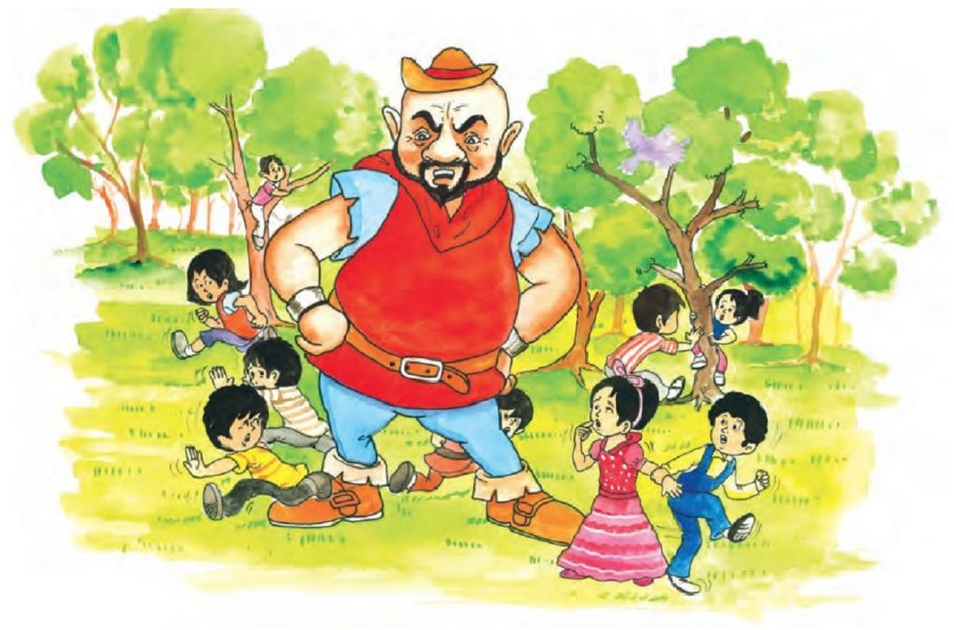
The Selfish Giant part-1
Summary

Slide 2
The opening lines suggest that the children were fond of playing in the Giant garden. It was a lovely garden with soft grass and beautiful flowers. It had twelve peach trees that flourish with pink and pearl flowers in spring season turn into rich fruits in the autumn. The children listened to the songs of various birds and thus lived in ecstasy.
Their enjoyment had ended with the arrival of the Giant. Who was away for last seven years to a friend’s house. He was infuriated when he saw children playing in his garden. He started shouting and built a high wall around it. He put up a notice that trespassing from his property is prohibited.

Slide 3
The decision took a toll on children as they did not have a place to play because if they play on the road, there was a lot of dust and stones. They were very sad and depressed.
As the time passed by, spring season came and flowers blossomed everywhere and little birds were chirping all around. But it did not arrive in Giants’ garden. There were barren winters only.
Trees and flowers were not blossoming. No birds were chirping. However, the snow and the frost were happy. The snow-covered up the grass with her white cloak and frost covered trees.

Slide 4
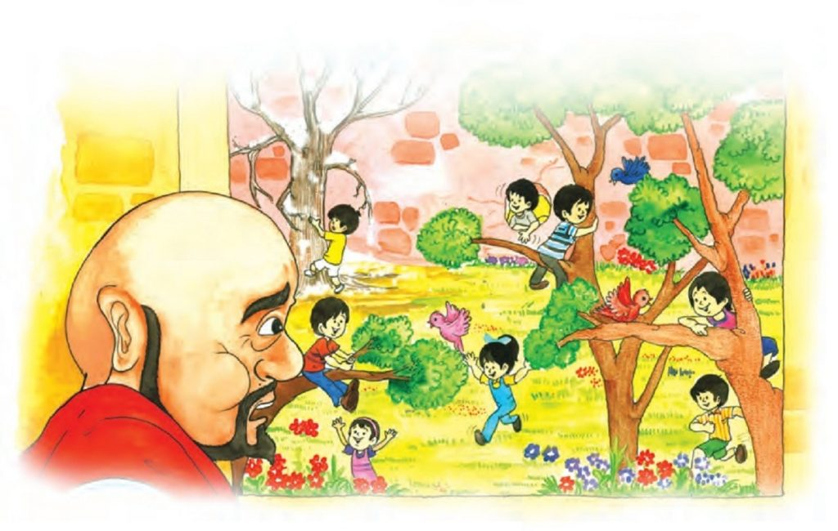

Slide 5
The north wind was invited to stay by them. They brought chaos in the garden. Then they planned to invite hail, he fell on the roof of the castle and broke most of its spates. He was dressed in grey.
However, the Giant was waiting eagerly and was hopeful. One morning, the Giant heard the melodious song of a bird. Initially, the Giant thought that it must be the king’s musician passing by.
Then Giant rejoiced as he was sure that the spring has arrived. He looked out and found that children were back

Slide 6
Word Meanings
bore : to carry
ogre : a hideous giant of fairy tales and folklore that feeds on human beings
gruff : a rough voice
trespassers :a person entering someone’s land or property without permission

Slide 7
prosecuted : punished
frost: the thin, white layer of ice that forms when the air temperature is below the freezing point of water
ceased: stop
casement: a window or part of a window set on a vertical hinge so that it opens like a door

