Slide 1
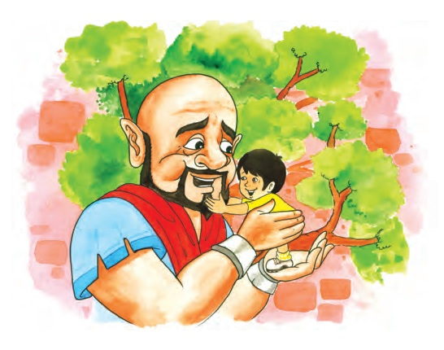
The Selfish Giant part-2
By Oscar Wilde

Slide 2
Every tree was blossoming as a child was sitting on its branch.
The birds were flying, flowers were laughing except for a place where a small child could not climb the tree. The poor tree wanted the child as frost, snow and north wind were blowing on that. The Giant realized his mistake and decided to break the wall.
He went downstairs and opened the front door. But the children were frightened to see him. The small boy could not run away. The Giant lifted the boy and put him onto a branch of the tree. The tree blossomed at once.

Slide 3
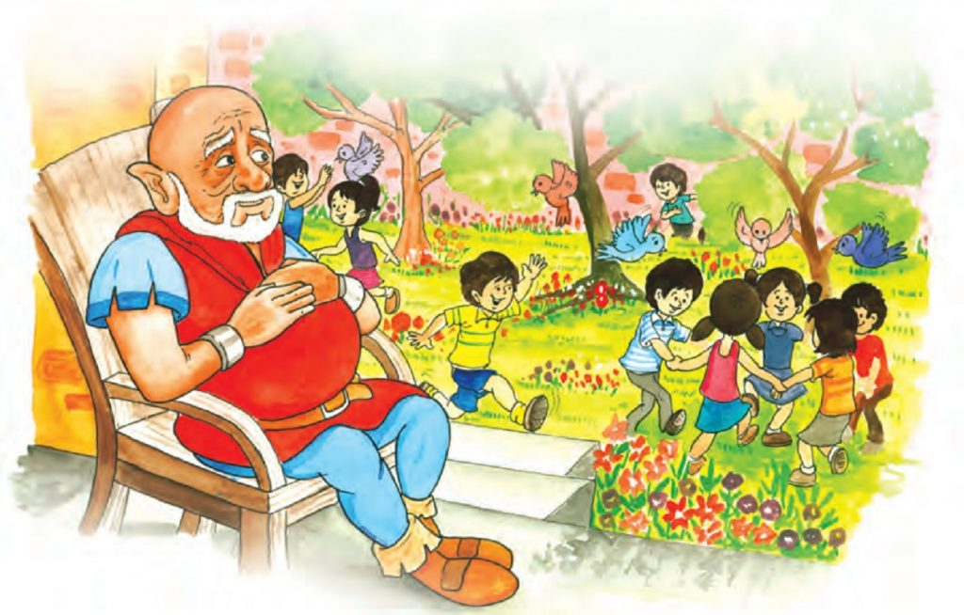

Slide 4
The Giant’s behaviour was changed and he allowed the other children. Then they entered the spring. Jubilant Giant took an axe and knocked down the wall. People were surprised to see the children playing with the Giant.
The Giant invited every child to visit his garden with special mention to the youngest child. But nobody knew him. The Giant was kind to every child. Years rolled by, the Giant grew old. He watched the children playing while sitting in an armchair. He said that the children are the most beautiful flowers of all.
The Giant no longer hated the winters. One winter morning, he was surprised to see the lovely white blossoms. Its branches were golden bearing silver fruit. There was the little boy sitting underneath.

Slide 5
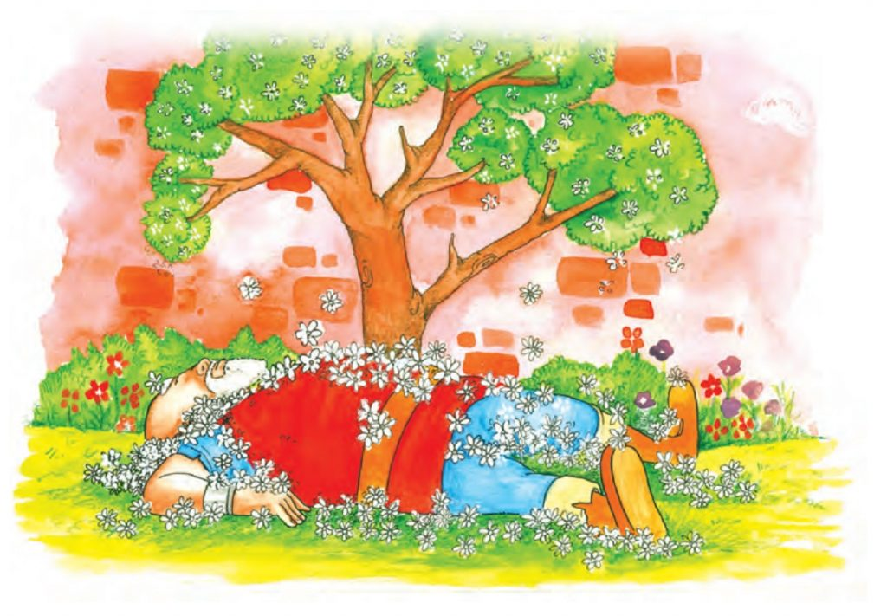
He was very happy and rushed towards him. On seeing his hands, he grew angry. He wanted to punish the wrongdoer. But the child replied that those were wounds of love. The Giant was shocked to hear such an answer.
He then asked about him who replied gently that once he allowed him to play him in his garden. Now he would take him along. When children came to play in the afternoon, they found the Giant lying dead covered with white blossoms.

Slide 6
Word Meanings
stole up: move quietly without letting anyone know
flung : throw
wicked: evil
feeble : weak
marvellous: extremely good or pleasing
hastened : rush quickly
slay: kill
awe : a feeling of reverential respect mixed with fear or wonder

