Slide 1
GEOGRAPHY LESSON 2 LESSON 2 LAND, SOIL, WATER, NATURAL VEGETATION AND WILD LIFE RESOURCES (MODULE:3)

Slide 2
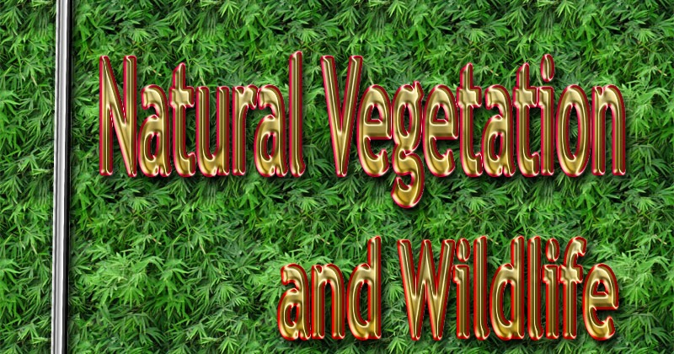

Slide 3
Natural vegetation and wildlife
Natural vegetation and wildlife exist only in a narrow zone of contact between the lithosphere, hydrosphere and atmosphere and this narrow zone is called biosphere.

Slide 4
Lithosphere is the solid portion of earth.
Hydrosphere is the domain of water.
Atmosphere is the layer of gases.
In biosphere living organisms are interrelated and interdependent on each other for their survival. This life supporting system is called eco system

Slide 5
Uses of natural vegetation and wildlife
Plants provide us with timber, give shelter to animals, produce oxygen, control soil erosion and give us fruits, nuts, latex, paper and medicinal plants.

Slide 6
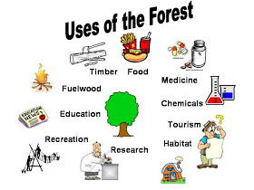

Slide 7
Wildlife includes animals, birds, insects and aquatic life forms. They provide us milk, meat, hides and wool. Insects provide honey, help in pollination of flowers and have an important role to play as decomposers in the ecosystem

Slide 8
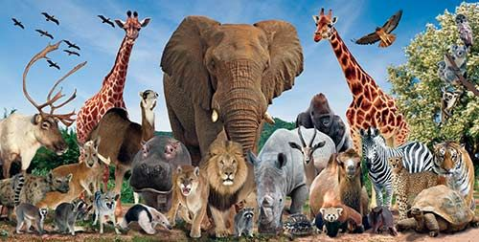

Slide 9
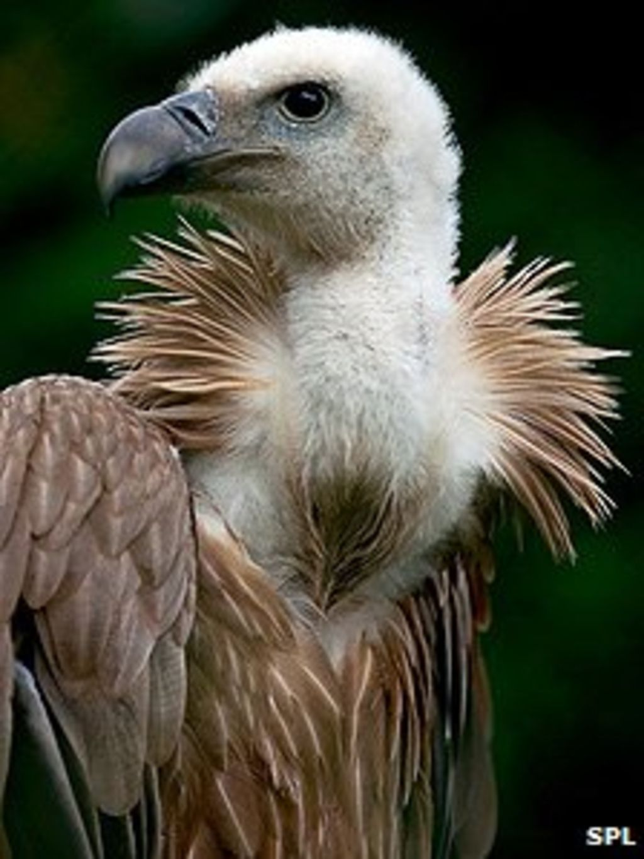

Slide 10
Distribution of natural vegetation
Vegetation that grows naturally without the interference of human beings is called natural vegetation. Generally, they are grouped under three categories
forest
grasslands
shrubs and tundra.

Slide 11
In the areas of heavy rainfall, we find forests. Short stunted trees and grasses grow in regions of moderate rainfall. Thorny shrubs and scrubs grow in dry region or areas of low rainfall.
Forests are broadly divided into evergreen and deciduous depending on when they shed their leaves. Evergreen forests do not shed their leaves simultaneously. Deciduous forests shed their leaves in a particular season to conserve the loss of moisture.

Slide 12
Conservation of Natural Vegetation and Wildlife
Many species have become vulnerable or endangered and some are on the verge of extinction.
The reasons are
Deforestation, soil erosion, construction activities, forest fire tsunami, landslide and hunting which result in a sharp decline in the number of particular species. So it is very important to conserve the resources.

Slide 13
Methods of conservation
Construction of national park, wildlife sanctuaries, biosphere reserves
Conservation of creeks, lakes and wetland is necessary to save the precious resource from depletion.
Awareness programme like social forestry and Van mahotsav should be encouraged at the regional and community level
Framing laws against illegal hunting. Many countries have passed laws against trade as well as killing of birds and animals.

Slide 14
